Slide 1

1
Strategies for Achieving a Prosperous and Empowered Upper Middle Income Society by 2030
Presentation by
Hon. Prof. Mthuli Ncube
Minister of Finance and Economic Development
APRIL 2019

Slide 2
Outline
2
Introduction
Vision 2030 and TSP
Progress on Economic Reforms
Monetary Sector Reforms
Institutional and Political Reforms
Arrears Clearance
Cyclone Idai
Sector Focus

Slide 3
Introduction
3
◆ The new Government, guided by His Excellency, the President, E. D. Mnangagwa, is on a transformative journey aimed at re-building the economy to realise the Vision 2030 goals of a ‘Prosperous and Empowered Upper Middle Income Society’;
◆ This initiative is in line with continental and inter-continental commitments towards attainment of the Sustainable Development Goals and the AU Agenda 2063;
◆ The aim is to improve the livelihoods of the majority of Zimbabweans through improved access to basic services and higher incomes;
◆ This can only be achieved through good governance based on the rule of law, as well as respect for human and property rights;

Slide 4
Introduction cont
4
◆ The New Dispensation – breakaway from the past;
◆ Zimbabwe is undertaking international re-engagement (political and economic);
◆ Vision 2030, seeks to transform Zimbabwe into an Upper Middle Income Economy by 2030;
◆ Transitional Stabilisation Programme (October 2018 – December 2020 ) is the policy implementation programme for Vision 2030;

Slide 5

ZIMBABWE VISION 2030
5
Governance | Macro- Economic Stability & Financial Re- Engagement | Inclusive Growth | Infrastructure & Utilities | Social Development
Cross Cutting Themes

Slide 6
Vision 2030 values & objectives
6
◆ Improved Governance and the Rule of Law.
◆ Re-orientation of the country towards Democracy.
◆ Upholding Freedoms of Expression and Association.
◆ Peace and National Unity.
◆ Respect for Human and Property Rights.
◆ Attainment of Responsive Public Institutions.
◆ Broad based Citizenry Participation in national and socio-economic development programmes.
◆ Political and Economic Re-engagement with the global community.
◆ Creation of a Competitive and Friendly Business Environment.
◆ Enhanced domestic and foreign investment.
◆ An aggressive fight against all forms of Corruption.

Slide 7
Roadmap to Vision 2030
7
◆ Government has a roadmap to ensure attainment of the people’s aspirations under Vision 2030.
◆ The roadmap involves a staged approach with the first phase being the ongoing implementation of the Transitional Stabilisation Programme up to 2020.
◆ The second and third stages involve the formulation and implementation of two five year national development strategies.
◆ The step-by-step approach allows for prioritisation of policies and interventions necessary for setting of the foundations for a longer term sustainable growth over the Vision 2030 horizon.

Slide 8
Roadmap to Vision 2030 cont
8
Two Five Year Development Plans
◆ The subsequent two five-year development plans will focus on putting in place the appropriate hard infrastructure in place, in the areas of energy, transport, as well as water and sanitation, among others.
◆ In addition, investment in soft infrastructure in the form of ICT will be advanced.

Slide 9
Transitional Stabilisation Programme
9
◆ Stabilising the macro-economy, and the financial sector.
◆ Introducing necessary policy, and institutional reforms, to transform to a private sector led economy.
◆ Launching quick-wins to stimulate growth, as well as to attract and encourage foreign direct investment.

Slide 10
Reversing Macro-Economic Imbalances
10
◆ Macro-economic Environment.
◆ Restoration of Fiscal Balance
◆ Mobilising Domestic Savings.
◆ Competitiveness of Exporters.

Slide 11
Upper Middle Income Society
11
Despite all the challenges, the economy still remains vibrant.
Target per capita income level of at least US$4 500 by 2030.
This implies a sustained growth in nominal GDP from the 2018 levels of around US$25 billion to around US$65 billion by 2030.
The private sector is expected to stimulate growth, with Zimbabwe assuming the position of a factory to the world.
This will be complemented by increased competition to bring down prices.

Slide 12
Leveraging Zimbabwe
12
◆ Zimbabwe as the gateway into Africa.
◆ Zimbabwe as a regional transit country.
◆ Zimbabwe as gateway for Africa into the World.
◆ Zimbabwe as factory for Africa.

Slide 13
Progress on TSP and Road to Vision 2030
13

Slide 14
Fiscal Intervention
14
◆ Treasury has a big role to play in terms of attainment of the Vision 2030 through providing an enabling environment, and also availing fiscal incentives in the Special Economic Zones to stimulate domestic production.
◆ Going forward, Treasury will continue with fiscal prudence by adhering to fiscal rules, to ensure a stable macro-economic environment.
◆ Government will crowd in the private sector in the development of public infrastructure, as a way of sharing the financial burden and promoting the local industry.

Slide 15

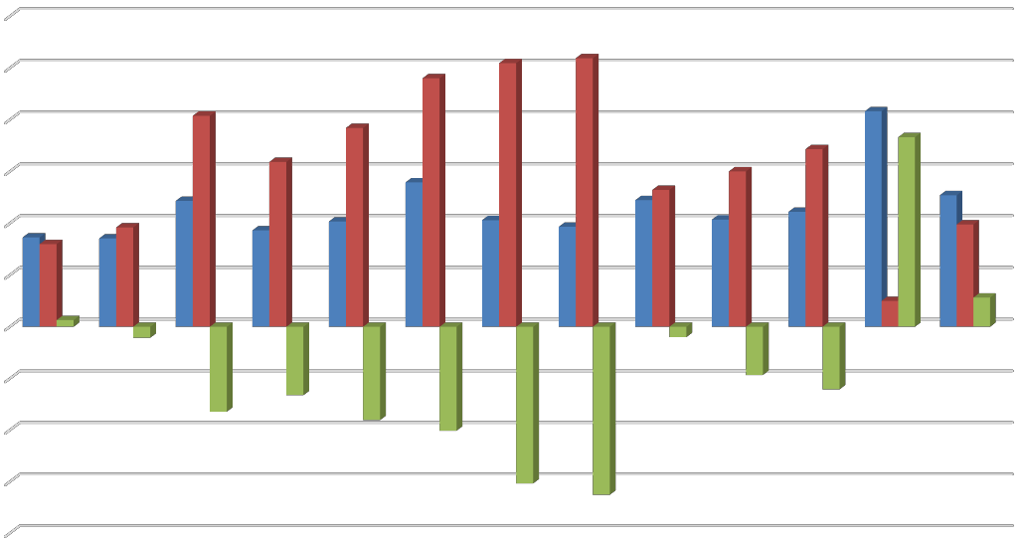
Fiscal Consolidation
15
Public Finances: Jan 2018 – Jan 2019
◆ The target is to reduce budget deficits from about 12% of GDP in 2018 to 5% in 2019.
◆ Revenue collection
◆ 2% Intermediated Mobile Transfer Tax
◆ Improvement of Tax Administration
◆ Expenditure Containment Measures
◆ Treasury Bills
◆ Public Wage Bill (5% salary cut for senior Government Officials; Rationalisation of posts)
◆ 13th Cheque Payment
◆ Freeze on Hiring
◆ Procurement of vehicles
◆ Average surplus of US$100 million a month since September 2018
US$ Million
Jan-18
Feb-18
Mar-18
Apr-18
May-18
Jun-18
Jul-18
Aug-18
Sep-18
Oct-18
Nov-18
Dec-18
Jan-19
Jan-18 Feb-18 Mar-18 Apr-18 May-18 Jun-18 Jul-18 Aug-18 Sep-18 Oct-18 Nov-18 Dec-18 Jan-19
Revenue
Expenditure
Budget Balance

Slide 16
Wage Bill Containment Measures
16
◆ Maintaining freeze on filling non-critical posts.
◆ Enforcing Retirement Policy.
◆ Implementation of new policy on Personal Issue Vehicles.
◆ Rationalisation of Foreign Service Missions.
◆ Reviewing conditions of service for Locally Recruited Staff at our Diplomatic
Missions.
◆ Relating outlays on bonus payments to Budget financial capacity.
◆ Interfacing the Payroll & Pension Systems, Public Finance Management System and the HR Management Information System.
◆ Strengthening payroll controls.

Slide 17
Key Infrastructure Projects
17
◆ Beitbridge – Harare – Chirundu Highway.
◆ Beitbridge – Victoria Falls Highway.
◆ Hwange 7 & 8.
◆ Batoka Gorge Dam and Power Station
◆ Kondo Dam.
◆ The Ministry of Environment, Water and Climate has also floated tenders for international projects.

Slide 18
Inflation
18
◆ Year on year inflation recorded 56.7% by January 2019 from 20.9% in October and 5.4%
in September 2018
◆ Government has, therefore, further strengthened efforts on implementation of fiscal consolidation measures targeting
Inflation Developments
narrowing the fiscal deficit and slowing down
money supply growth starting in October 2018
◆ This has seen month-on-month inflation slowing down to 9.2% and 9% in November and December 2018, from 16% in October 2018
◆ Monthly inflation for February 2019 is 1.7%, whilst the inflation trend is downward
Jan-17
Feb-17
Mar-17 Apr-17 May-17 Jun-17 Jul-17 Aug-17 Sep-17 Oct-17 Nov-17 Dec-17 Jan-18 Feb-18 Mar-18 Apr-18 May-18 Jun-18 Jul-18 Aug-18 Sep-18 Oct-18 Nov-18 Dec-18 Jan-19
Inflation
Parrel Market Exchange Premiums
Money Supply Growth

Slide 19
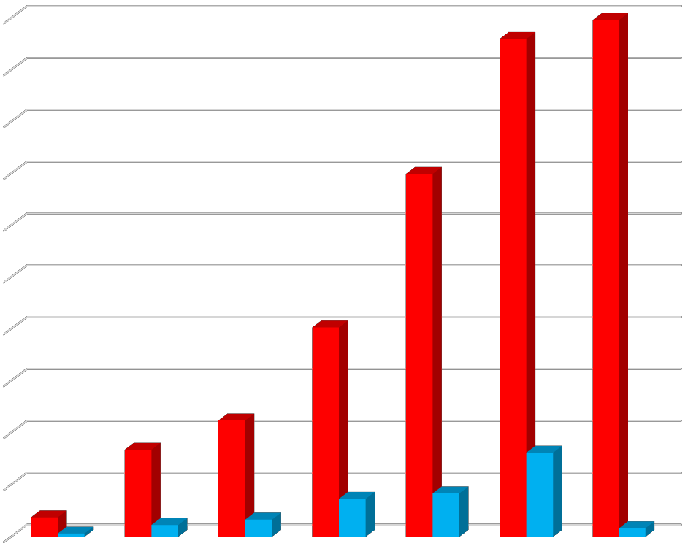
Domestic Debt
19
◆ Treasury stopped resorting to the RBZ overdraft facility;
◆ In 2018, payments towards domestic debt amounted to US$1.62 billion.
◆ In January and February 2019 payments towards domestic debt amount to US$195 million
US$ billion
2013
2014
2015
2016 2017
Repayment
2018
2019
Debt Stock

Slide 20
Options for Arrears Clearance
20
◆ Government is committed to implementing reforms and completing the Arrears Clearance Road Map;
◆ The fiscal reform and re-engagement efforts are setting the country back in the arrears clearance plan;
◆ Government will continue engaging all bilateral and multilateral creditors.

Slide 21
Monetary Sector and Currency Reforms
21
Separation of FCA accounts and RTGS accounts in October 2018 - set the tone for the implementation of currency reforms
Liberalisation of the exchange rate – establishment on an Inter-Bank Foreign Currency market;
Setting up of a robust market based framework for determination of the exchange rate to facilitate financial sector stability, containment of inflationary pressures and building of confidence

Slide 22
Monetary Sector and Currency Reforms
22
◆ Conversion of local USD accounts into RTGS dollar accounts;
◆ Use of RTGS dollar as reference currency;
◆ Removal of distortions including multi-tier pricing of goods and services (USD, Bond Notes, RTGS, Ecocash)

Slide 23
State Owned Enterprises and Parastatals Reforms
23
◆ GMB: unbundling of the Grain Marketing Board into Strategic Grain Reserve Unit and Commercial Entity
◆ Allied Timbers
◆ ZESA: re-bundling of ZESA and to merge all the 5 separate units into a single integrated company with one board
◆ Lotteries and Gaming Board
◆ National Competitiveness Commission
◆ Partial privatisation of the Industrial Development
Corporation of Zimbabwe …. Willowvale Motor Industries
◆ Partial privatisation of NetOne and TelOne

Slide 24
Sector Focus
24

Slide 25
Importance of Reviving the Manufacturing Sector
25
◆ The country has been exporting raw products, while importing finished products, sustaining widening of the current account deficit.
◆ The solution to this current account deficit lies in value addition and beneficiation, so that the country earns higher value on the foreign market.
◆ High levels of formal unemployment can also be easily addressed by resuscitation of the manufacturing sector.

Slide 26
Resuscitation of Distressed Companies
26
◆ The economy used to boast of countrywide strategic companies which employed a significant number of workers with strong backward and forward linkages with the rest of the economy.
◆ Some of the companies include David Whitehead Textiles, Cold Storage, Border Timbers, Railways of Zimbabwe, Hwange Colliery and Zimbabwe Iron and Steel Company, among others.
◆ As a result, Government will make deliberate and targeted interventions to facilitate the re-opening and resuscitation of such companies through various financing mechanisms particularly joint ventures with private investors.
◆ Furthermore, Government will advance the ongoing State Owned Enterprise reforms to improve service delivery and reduce the financial burden on the fiscus.

Slide 27
Strategies to Revive
Production
27
◆ Government is in the process of fully operationalising Special Economic Zones to help attraction of investment, technology transfer, beneficiation and value addition, creation of employment and generation of exports.
◆ The target is to complete the following:
Sunway City in Harare, focussing on the high technology hub;
Victoria Falls, covering tourism and financial services;
Bulawayo, focussing on beef to leather industry, cotton to textile industry, steel and foundry, and the rehabilitation of the NRZ, among other value chains; and
Mutare Special Economic Zone, which will focus on diamond cutting and polishing.

Slide 28
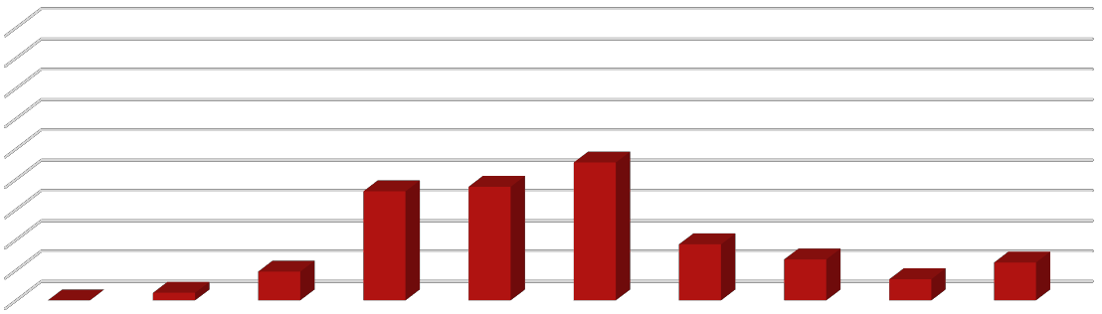
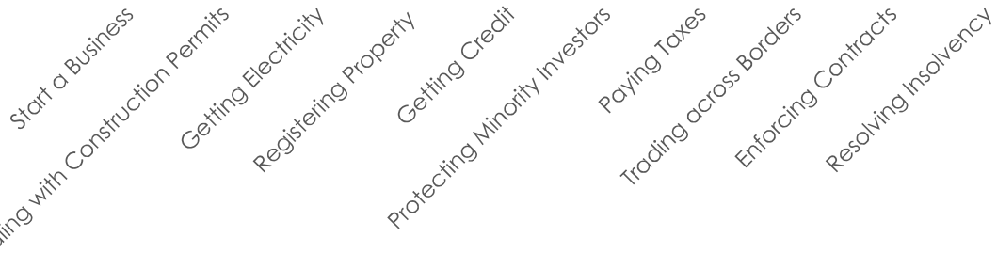
Ease of Doing Business Reforms
28
Rankings on Doing Business: Zimbabwe (2018)
◆ Establishment of a One-Stop Shop Investment Centre.
◆ Currently in the process of amalgamating the Joint Venture Unit, Zimbabwe Special Economic Zones Authority and the Zimbabwe Investment Authority into the Zimbabwe Investment and Development Agency.
◆ Zimbabwe Investment and Development Agency Bill now before Parliament.
0
20
40
60
80
100
120
140
160
180
108
105
89
161
143
153
155
180
175
166

Slide 29
Agriculture
29
Zimbabwe’s agricultural sector is flush with investment opportunities.
Agriculture remains a mainstay of the Zimbabwean economy, accounting for 10.5% of GDP in 2017 and employing 60-70% of the workforce.
The el-nino induced drought during the 2018/2019 agricultural season might see revised forecasts of agricultural output

Slide 30
Mining
30
World-Class Geological Endowment: All 40 major minerals have been identified.
Second largest platinum reserves and second largest producer of ferrochrome in Africa.
Zimbabwe requires an estimated US$11 billon of Capex to modernise its existing mines.
Furthermore, almost all minerals are exported from Zimbabwe in their unprocessed state. This allows opportunities for investors in the value-add stage of production.
Zimbabwe’s highly anticipated gold sector is on a ten-year growth path.

Slide 31
Institutional Reforms
31

Slide 32
Legislative Agenda
32
◆ Repeal of Public Order and Security Act (POSA) and Access to Information and Protection of Privacy Act (AIPPA).
Cyber Protection, Data Protection, and Electronic Transactions Bill
◆ Citizenship laws
◆ Police Act
◆ Political Dialogue

Slide 33
Legislative Agenda
33
Indigenisation and Economic Empowerment Act amended;
The companies and Other Entities Bill;
The Regional Town and Country Planning Amendment Bill;
The Zimbabwe Investment and Development Agency Bill;
The Citizenship of Zimbabwe Act and the Immigration Act to be amended;
The Mines and Minerals Amendment Bill;
The Gold Trade Bill and the Precious Stones Trade Bill;
The Institute of Education Research, Innovation and Development Bill;
Consumer Protection Bill;
Zimbabwe Media Commission Bill and amendment of the Broadcasting Services Act;
Cyber Crime & Cyber Security Bill;

Slide 34
Land Reform
34
◆ Government is commited to implement the Constitution requirement for compensation;
◆ Government is finalising valuation of farms to engage farmers who have already completed their valuations;
◆ A Cabinet Committee is in place to spearhead discussions between Government and farmers;
◆ Some compensation had began, but discontinued to allow Government to carryout a
wholesome compensation programme;
◆ After completion of valuations and engagements with farmers on the total value of the compensation – likely options for compensation will be to treat the value as domestic debt or foreign debt.
◆ Creation of a "Land Bank" would allow the debt to be off balance sheet.
◆ Sale of land around major urban areas

Slide 35
Devolution
35
◆ $319 million allocated in 2019;
◆ Afocus is on projects that create jobs;
◆ Resource allocation based on quality of infrastructure, levels of poverty and population size.

Slide 36

I THANK YOU
36

